Slide 1
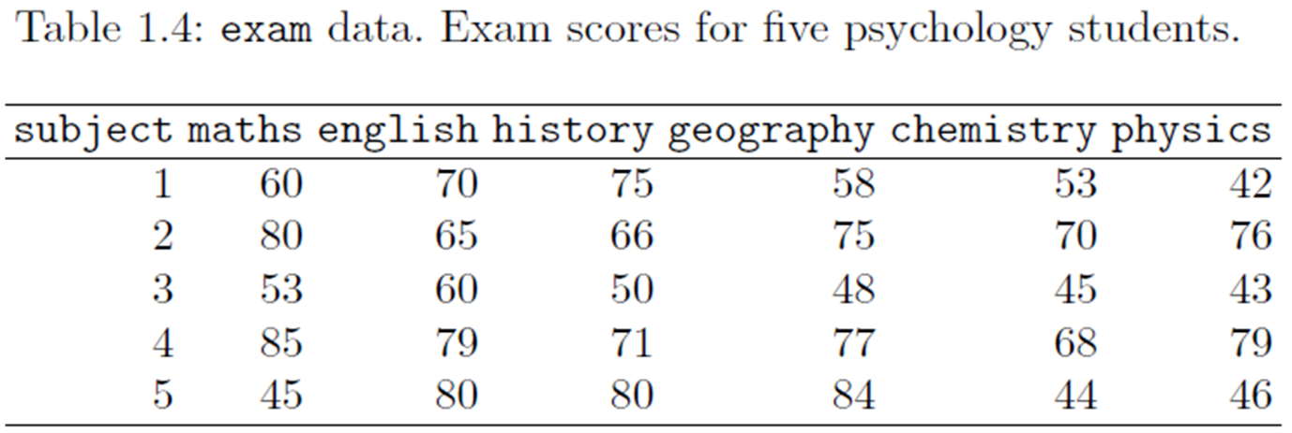
Chapter 2: Looking at Multivariate Data
2.1 Why graphically display data
Multivariate data could be presented in tables, but graphical presentations are more effective at displaying patterns

Slide 2
Graphical displays may:
provide an overview,
suggest a plausible model for the data,
assess validity of model assumptions,
detect outliers, or
suggest plausible normalizing transformations

Slide 3
2.2 Display bivariate data
The basic scatter plot
Using scatter plots to describe relationships between pairs of variables (at least with interval level of measurements), assess linearity, find linearizing transformations, and detect outliers.
b. Using rug plot or histogram or boxplot to show marginal distributions (Considering each single variable separated).
c. Labeling points with abbreviations to identify interesting observations.
d. A regression line or curve overlain on the plot.

Slide 4
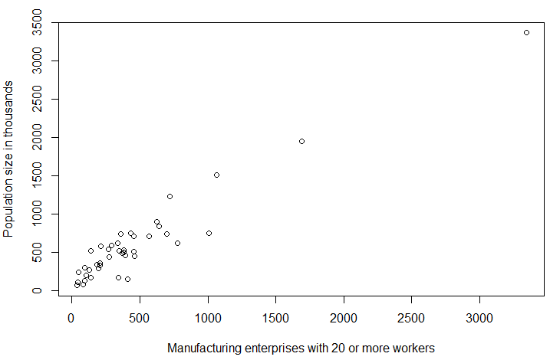
Ex 2.2.1
a. Draw a scatter plot of the pairs of variables of manufacturer and population in USairpollution data and check the linearity.
Read the data into R
Define the labels of the two variables for the plot.
Use function “Plot”

Slide 5
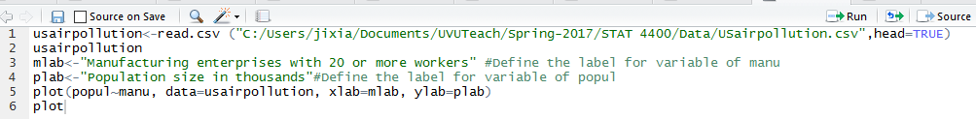
Ex 2.2.1
a. Draw a scatter plot of the pairs of variables of manufacturer and population in USairpollution data and check the linearity.

Slide 6
Ex 2.2.1 a. Draw a scatter plot and check the linearity.
Comments:
The plot clearly uncovers that
as the number of manufacturing enterprises increases, the population size increases as well. (Trend)
the presence of one or more cities that are some way from the remainder. Before commenting on these possible outliers we will construct the scatterplot again (find boundary such as lower and upper inner-fence).

Slide 7
b. Plotting the marginal distributions in rug plots and the joint distribution together. Labeling the outliers.
Plotting marginal and joint distributions together is usually good data analysis practice.
The marginal distribution shown as rug plots on each axis (produced by rug()),
Side=1 means x-axis
Side=2 means y-axis
……
rug(usairpollution$manu, side=1, color=2)
rug(usairpollution$popul, side=2, color=3)

Slide 8
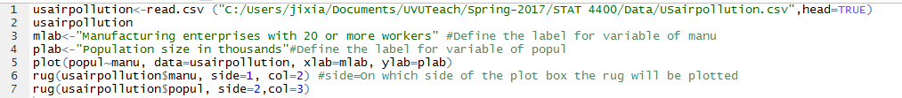
b. Plotting the marginal distributions in rug plots and the joint distribution together. Labeling the outliers.
Plotting marginal and joint distributions together is usually good data analysis practice.
The marginal distribution shown as rug plots on each axis (produced by rug()),

Slide 9
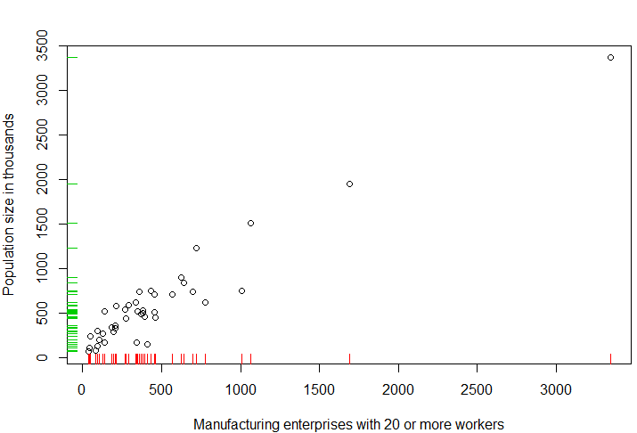
The outlying points show themselves in both the scatterplot of the variables and in each marginal distribution.
The most extreme outlier corresponds to Chicago, and other slightly less extreme outliers correspond to Philadelphia and Detroit. Each of these cities has a considerably larger population than other cities and also many more manufacturing enterprises.

Slide 10
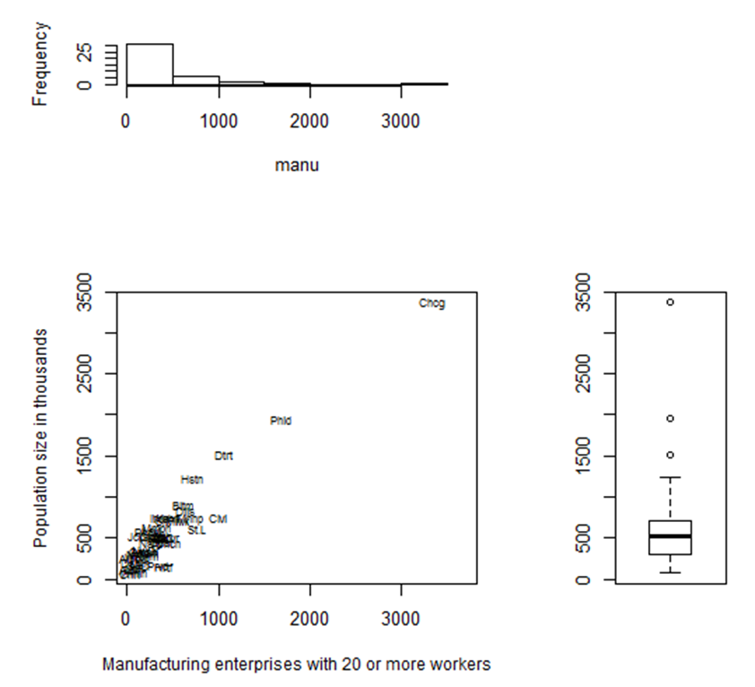
c. Plotting the marginal distributions in histogram or boxplot and the joint distribution together. Labeling the outliers

Slide 11
c. Plotting the marginal distributions in histogram or boxplot and the joint distribution together. Labeling the outliers.
Define layout
Define size of the plots
Draw the scatter plot
Labeling the outliers
Draw a marginal distribution in histogram
Draw another marginal distribution is boxplot.

Slide 12
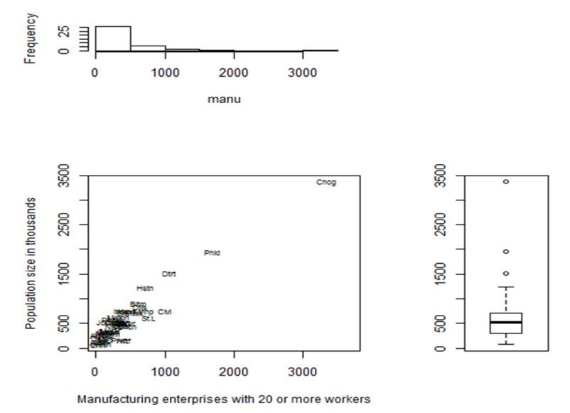
Define layout
layout(matrix(c(2,0,1,3), nrow = 2, byrow=TRUE), …….)
2nd Graph
0=No graph
2nd Graph | No Graph
1st Graph | 3rd Graph
1st Graph
3rd Graph

Slide 13

Define layout Define size
layout(matrix(c(2,0,1,3), nrow = 2, byrow=TRUE), widths=c(2,1),heights=c(1,2), respect=TRUE)
1 unit
2nd Graph | No Graph
1st Graph | 3rd Graph
heights=c(1,2)
2 units
Widths: (2 units, 1 unit)

Slide 14
xlim<-with(usairpollution,range(manu))*1.1
"xlim: defines coordinate range of X axis of a plot
range(manu))*1.1 # X axis is from 1.1*min(manu) to 1.1*max(manu). Note because 1.1*min(manu) is relatively too small, the min X tick in the plot shows as 0.
with: with(data, do something to the data).
plot(popul~manu,data=usairpollution, cex.lab=0.9, xlab=mlab,ylab=plab, type="n", xlim=xlim)

Slide 15
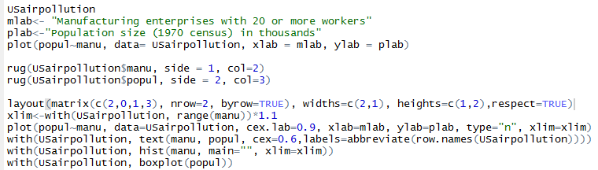

Slide 16
2. The bivariate boxplot
An two-dimensional analogue of the familiar boxplot. Instead of boxes, it displays two ellipses centered at the same point (the bivariate center).
The smaller ellipse contains the central 50% of the data and the wider ellipse contains all the data except the outliers.
Two regression lines are displayed (the regression of Y on X and that of X on Y ). The intersection of the regression lines is the bivariate center of the data.
If the angle between the lines is highly acute, this indicates a strong correlation between the two variables.
This plot can be done with the bvbox function. Options exist to use robust measures of center, spread, and association when constructing the bivariate boxplot.

Slide 17
Example 2.2.2
a. Draw a scatter plot of manufacture and population including the bivariate boxplot and show the outliers.
b. Compute the correlation coefficient between two variables with/without the potential outliers.
For bivariate boxplot, package “sp” is needed.

Slide 18
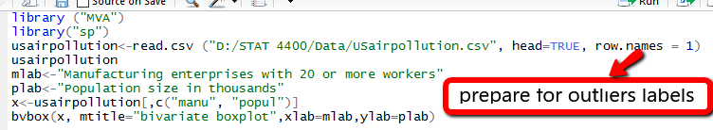
Draw a scatter plot including the bivariate boxplot and show the outliers

Slide 19
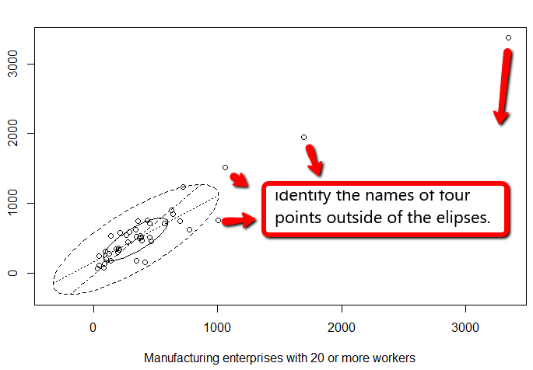
Draw a scatter plot including the bivariate boxplot and show the outliers

Slide 20
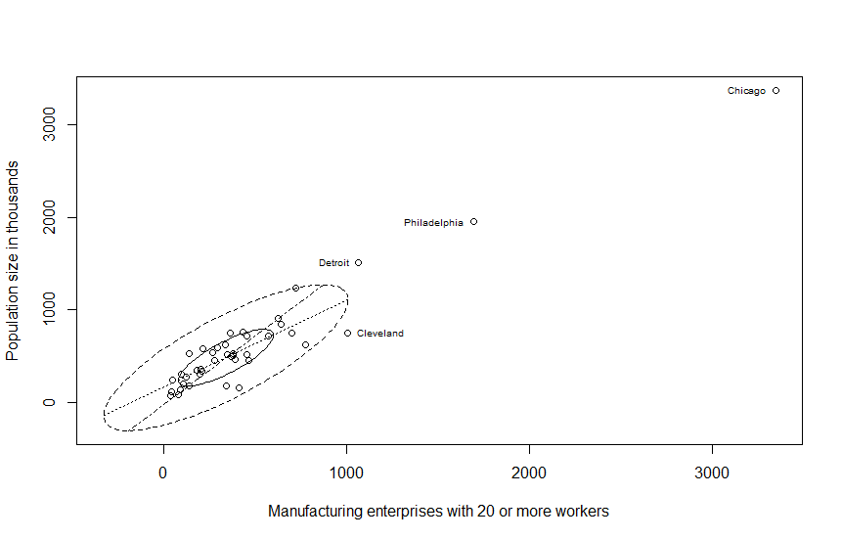
Draw a scatter plot including the bivariate boxplot and show the outliers
3
2
4
1
pos =position of text relative to the point

Slide 21
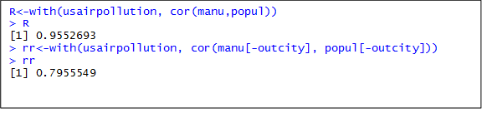

b. Compute the correlation coefficient between two variables with/without the potential outliers.
without
without

Slide 22
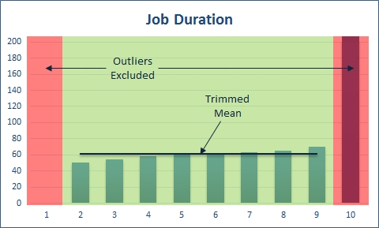
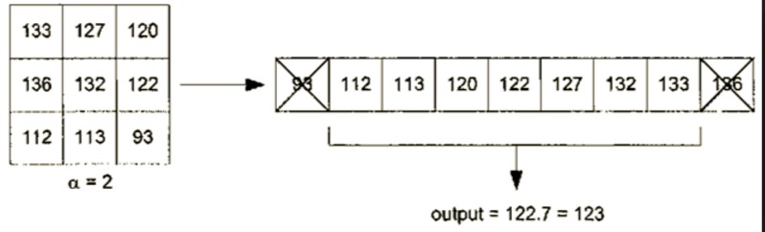
Trimmed mean

Slide 23
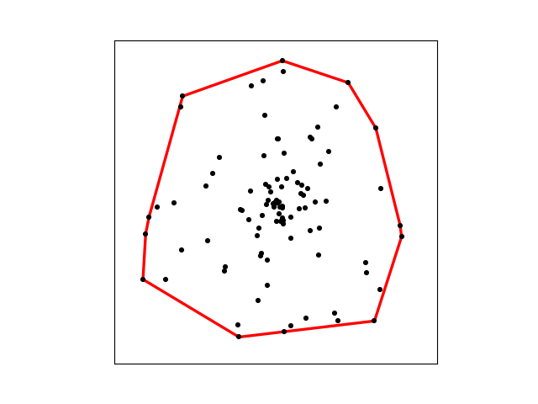
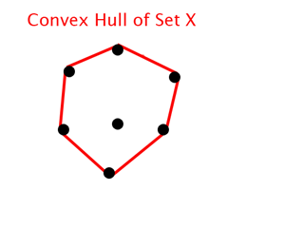
3. The Convex Hull of a data set: A robust measures which ignore outliers
The points on the edge of the smallest perimeter surrounding the data

Slide 24
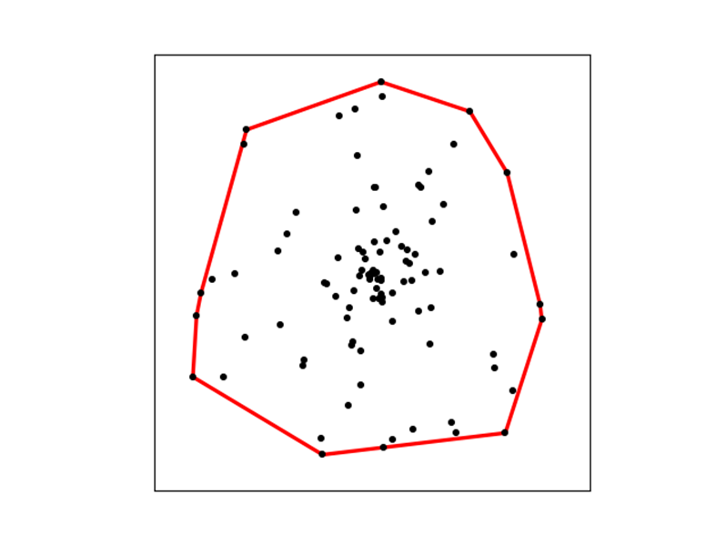
3. The Convex Hull of a data set: A robust measures which ignore outliers
Univariate: Highest and lowest observations are trimmed off the resulting data set may be more representative of the population. e.g. the trimmed mean.
Define the convex hull of the data set as the points on the edge of the smallest (convex) perimeter surrounding the data.
Trimming of these outlying observations on the convex hull may display the relationship between the variables better. Robust summary measurements (such as the correlation) can be obtained from this trimmed data set.

Slide 25
Ex 2.2.3
Find the convex hull of the data of Usairpollution with variables of the manufacture and population.
b. Draw a scatterplot of manufacture against population showing the convex hull of the data.
c. Calculate the correlation coefficient after removal of the convex hull of the data.

Slide 26
Ex 2.2.3
Find the convex hull of the data of Usairpollution with variables of the manufacture and population.
 |  | SO2 | temp | manu | popul | wind | precip | predays
1 | Albany | 46 | 47.6 | 44 | 116 | 8.8 | 33.36 | 135
2 | Albuquerque | 11 | 56.8 | 46 | 244 | 8.9 | 7.77 | 58
3 | Atlanta | 24 | 61.5 | 368 | 497 | 9.1 | 48.34 | 115
4 | Baltimore | 47 | 55 | 625 | 905 | 9.6 | 41.31 | 111
5 | Bualo | 11 | 47.1 | 391 | 463 | 12.4 | 36.11 | 166
6 | Charleston | 31 | 55.2 | 35 | 71 | 6.5 | 40.75 | 148
7 | Chicago | 110 | 50.6 | 3344 | 3369 | 10.4 | 34.44 | 122
8 | Cincinnati | 23 | 54 | 462 | 453 | 7.1 | 39.04 | 132
9 | Cleveland | 65 | 49.7 | 1007 | 751 | 10.9 | 34.99 | 155
10 | Columbus | 26 | 51.5 | 266 | 540 | 8.6 | 37.01 | 134
11 | Dallas | 9 | 66.2 | 641 | 844 | 10.9 | 35.94 | 78
12 | Denver | 17 | 51.9 | 454 | 515 | 9 | 12.95 | 86
13 | Des Moines | 17 | 49 | 104 | 201 | 11.2 | 30.85 | 103
14 | Detroit | 35 | 49.9 | 1064 | 1513 | 10.1 | 30.96 | 129
15 | Hartford | 56 | 49.1 | 412 | 158 | 9 | 43.37 | 127
16 | Houston | 10 | 68.9 | 721 | 1233 | 10.8 | 48.19 | 103
17 | Indianapolis | 28 | 52.3 | 361 | 746 | 9.7 | 38.74 | 121
18 | Jacksonville | 14 | 68.4 | 136 | 529 | 8.8 | 54.47 | 116
19 | Kansas City | 14 | 54.5 | 381 | 507 | 10 | 37 | 99
20 | Little Rock | 13 | 61 | 91 | 132 | 8.2 | 48.52 | 100
21 | Louisville | 30 | 55.6 | 291 | 593 | 8.3 | 43.11 | 123
22 | Memphis | 10 | 61.6 | 337 | 624 | 9.2 | 49.1 | 105
23 | Miami | 10 | 75.5 | 207 | 335 | 9 | 59.8 | 128
24 | Milwaukee | 16 | 45.7 | 569 | 717 | 11.8 | 29.07 | 123
25 | Minneapolis | 29 | 43.5 | 699 | 744 | 10.6 | 25.94 | 137
26 | Nashville | 18 | 59.4 | 275 | 448 | 7.9 | 46 | 119
27 | New Orlean | 9 | 68.3 | 204 | 361 | 8.4 | 56.77 | 113
28 | Norfolk | 31 | 59.3 | 96 | 308 | 10.6 | 44.68 | 116
29 | Omaha | 14 | 51.5 | 181 | 347 | 10.9 | 30.18 | 98
30 | Philadelphia | 69 | 54.6 | 1692 | 1950 | 9.6 | 39.93 | 115
31 | Phoenix | 10 | 70.3 | 213 | 582 | 6 | 7.05 | 36
32 | Pittsburgh | 61 | 50.4 | 347 | 520 | 9.4 | 36.22 | 147
33 | Providence | 94 | 50 | 343 | 179 | 10.6 | 42.75 | 125
34 | Richmond | 26 | 57.8 | 197 | 299 | 7.6 | 42.59 | 115
35 | Salt lake City | 28 | 51 | 137 | 176 | 8.7 | 15.17 | 89
36 | San rancisco | 12 | 56.7 | 453 | 716 | 8.7 | 20.66 | 67
37 | Seattle | 29 | 51.1 | 379 | 531 | 9.4 | 38.79 | 164
38 | St. Louis | 56 | 55.9 | 775 | 622 | 9.5 | 35.89 | 105
39 | Washington | 29 | 57.3 | 434 | 757 | 9.3 | 38.89 | 111
40 | Wichita | 8 | 56.6 | 125 | 277 | 12.7 | 30.58 | 82
41 | Wilmington | 36 | 54 | 80 | 80 | 9 | 40.25 | 114
hull<-with(usairpollution,chull(manu,popul))
> hull[1] 9 15 41 6 2 18 16 14 7
b. Draw a scatterplot of manu v.s. popul showing the convex hull.

Slide 27
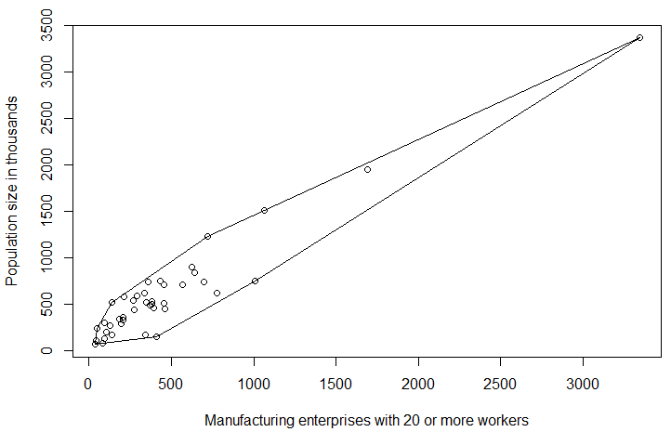
Ex 2.2.3
a.
hull<-with(usairpollution,chull(manu,popul))> hull[1] 9 15 41 6 2 18 16 14 7
b. Draw a scatterplot of manu v.s. popul showing the convex hull of the data.
with(usairpollution,plot(manu,popul,pch=1,xlab=mlab,ylab=plab))
with(usairpollution,polygon(manu[hull],popul[hull]))
pch= option to specify symbols to use when plotting points

Slide 28
hull<-with(usairpollution,chull(manu,popul)) hull[1] 9 15 41 6 2 18 16 14 7
Example 2.2.3
The convex hull
Draw convex hull
with(usairpollution,plot(manu,popul,pch=1,xlab=mlab,ylab=plab)) with(usairpollution,polygon(manu[hull],popul[hull]))
c. Calculate the correlation coefficient after removal of the convex hull of the data.
with(usairpollution,cor(manu[-hull],popul[-hull]))
[1] 0.9225267
with(usairpollution,cor(manu,popul))
[1] 0.9552693

Slide 29
Review: Tests for independence and the Homogeneity of proportions
a. The Chi-Square test for independence is used to determine whether there is an association between a row variable and column variable constructed from sample data.
H₀: The variables are not associated. (Independent) H₁: The variables are associated. (Dependent)
 |  | Marital Status
 |  | Married | Widowed | Divorced | Never married
 | Very happy
Happiness | Pretty happy
 | Not too happy

Slide 30
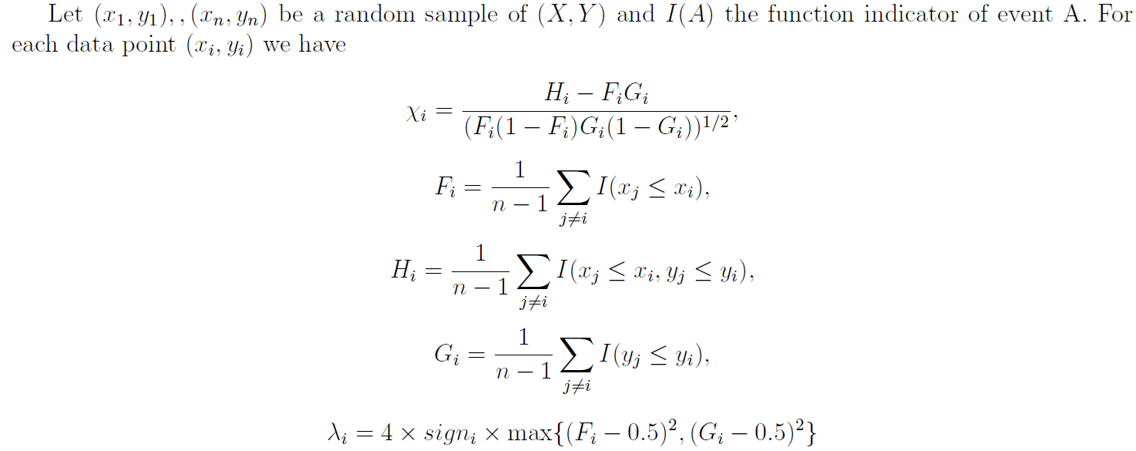
4. The Chi-plot
The chi-plot is a graphical method for judging whether two variables are independent, based on sample data.

Slide 31
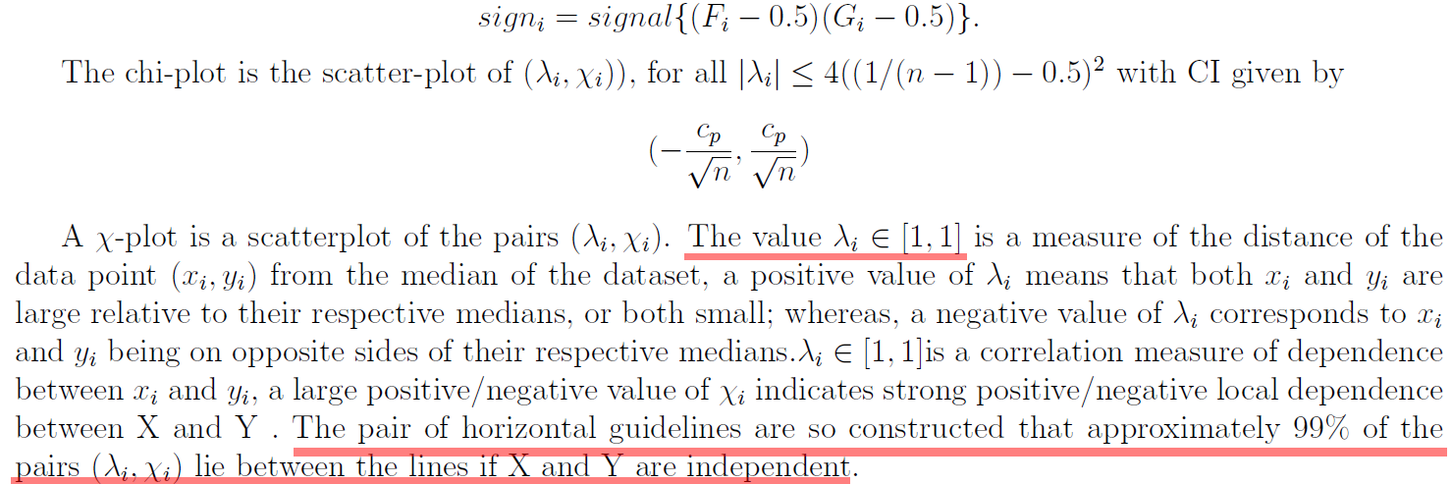

Slide 32
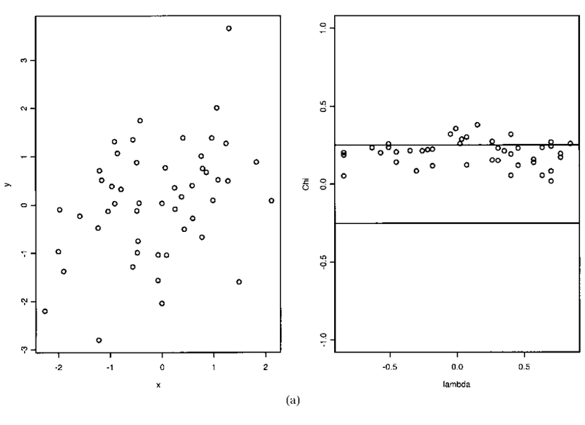
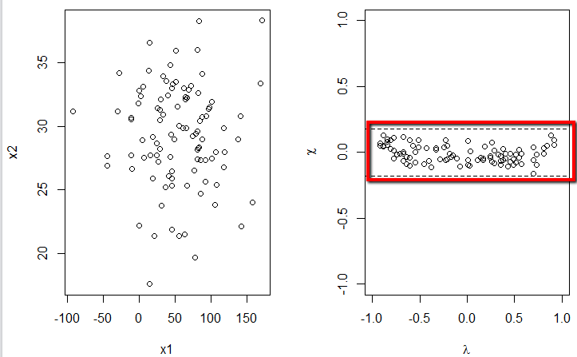
4. The Chi-plot
A graphical method for judging whether two variables are independent, based on sample data
dependence
independence
The Chi-plot is not within the central region
The Chi-plot falls within a central region

Slide 33
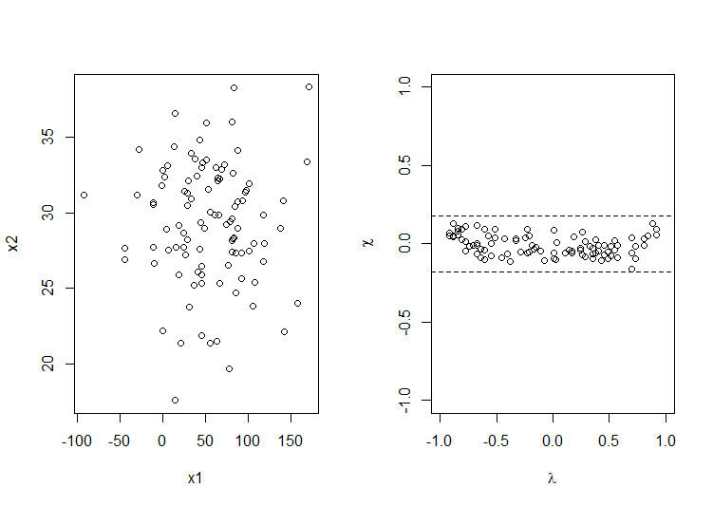
Ex 2.2.4 a. Generate two random variables from normal distributions. Draw scatterplot and chi-plot to verify the independence.
x1 <- rnorm(100, 50, 49)
x2 <- rnorm(100, 30, 4)
layout(matrix(c(1:2), nrow = 1))
plot(x1,x2)
chiplot(x1,x2)

Slide 34
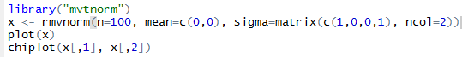
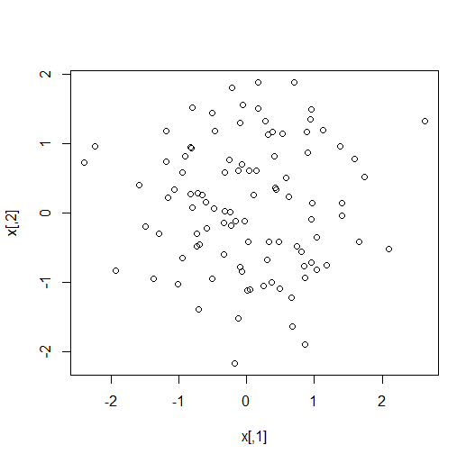
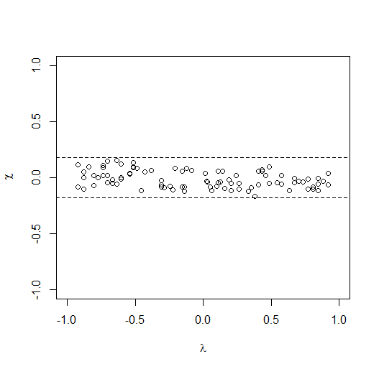
Ex 2.2.4 a. Generate two random variables from normal distributions. Draw scatterplot and chi-plot to verify the independence.

Slide 35
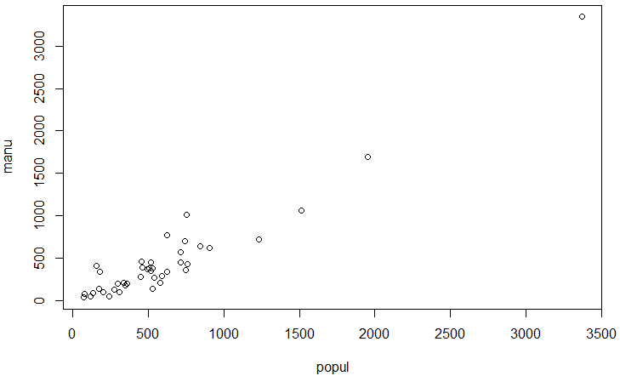
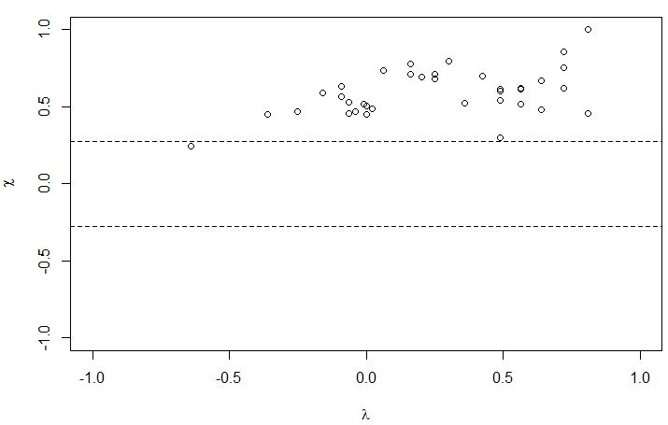
Ex 2.2.4 a. Generate two random variables from normal distributions. Draw scatterplot and chi-plot to verify the independence.
b. Draw chi-plot of USairpollution with variables of manufacture and population to verify the dependence.
with(usairpollution,plot(manu,popul,xlab=mlab,ylab=plab,cex.lab=0.9))
with(usairpollution,chiplot(manu,popul))

Slide 36
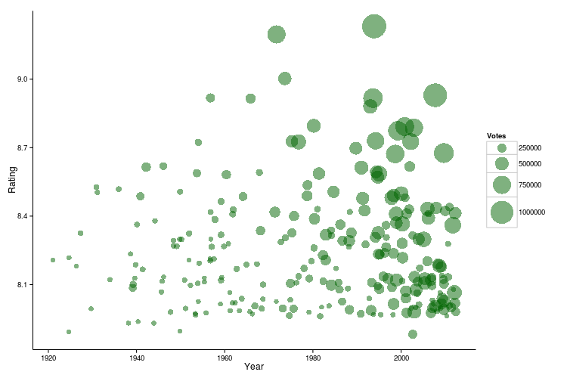
2.3 Display three dimensional multivariate data
1. The bubble plot and glyph: Show three variables on a regular 2-D plot and other glyph plot
Two variables are plotted as usual on a scatterplot. (Year v.s. Rating)
Circular bubbles are drawn around each point, with the size of the bubble representing the value of a third variable for that observation. (Votes)
The size of the bubble is the third dimension
The second dimension
The first dimension

Slide 37
Example 2.3.1 Use the bubble plots to visualize the relationship among the variables of temp, wind, and SO2 in data of USairpollution.
The Process of Thinking:
Identify the number of variables
Draw a scatter plot of two variables
Add the values of the third variable as bubbles: symbols function

Slide 38
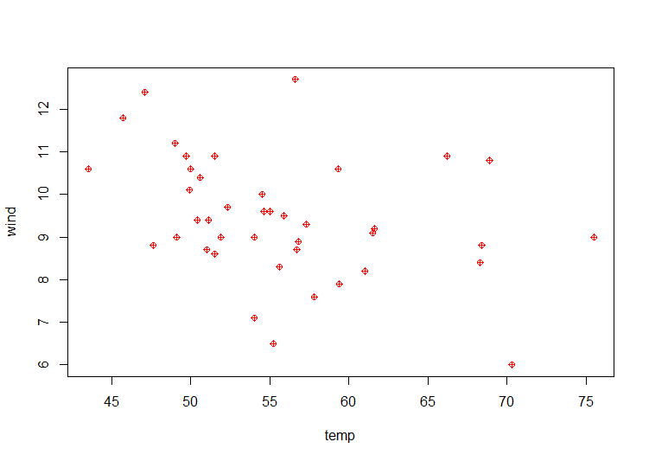
Ex 2.3.1 Use the bubble plots to visualize the relationship among the variables of temp, wind, and SO2 in data of USairpollution.
ylim <- with(USairpollution, range(wind)) * c(0.95, 1)
plot(wind ~ temp, data = USairpollution, xlab = "Average annual temperature (Fahrenheit)", ylab = "Average annual wind speed (m.p.h.)", pch = 10, col=“red”, ylim = ylim)

Slide 39
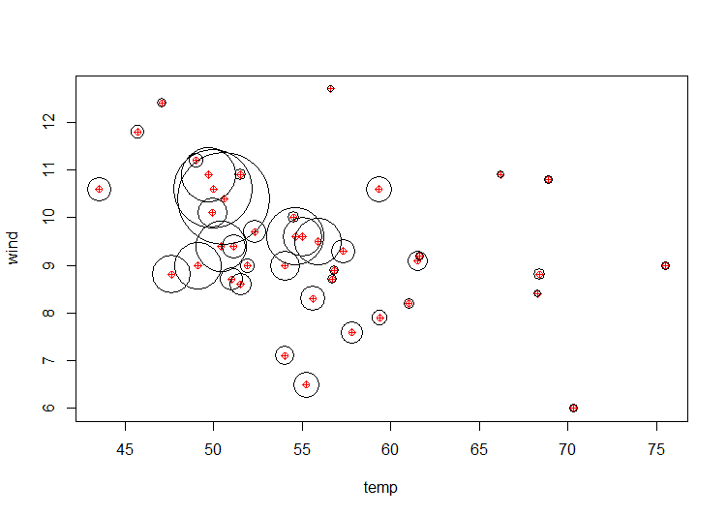
ylim <- with(USairpollution, range(wind)) * c(0.95, 1)
plot(wind ~ temp, data = USairpollution, xlab = "Average annual temperature (Fahrenheit)", ylab = "Average annual wind speed (m.p.h.)", pch = 10, ylim = ylim)
with(USairpollution, symbols(temp, wind, circles = SO2, inches = 0.5, add = TRUE))

Slide 40
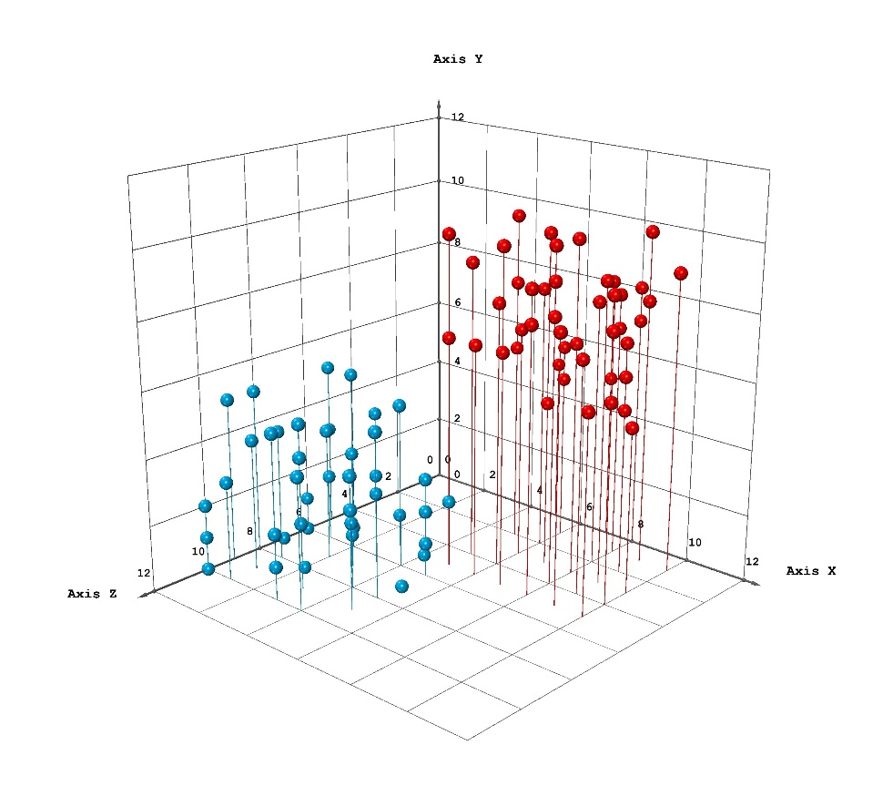
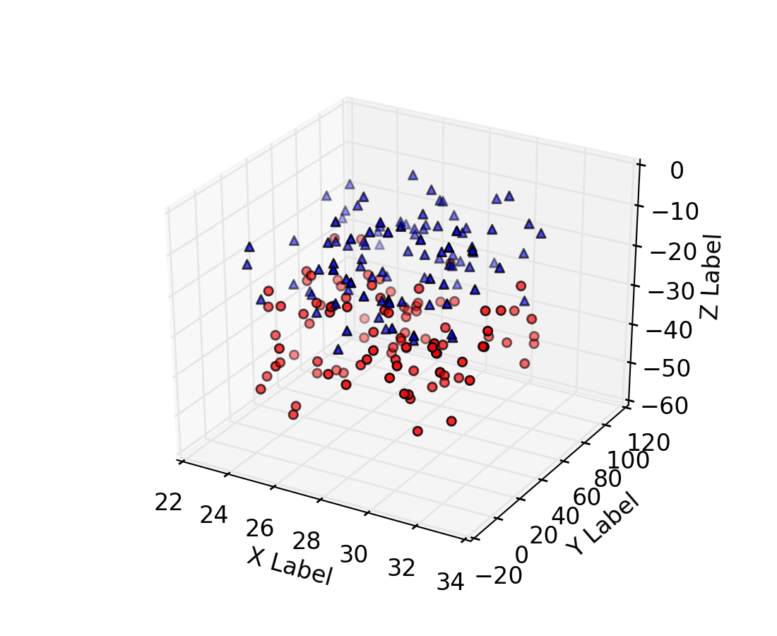
2. Three-Dimensional Scatterplots
3-D scatterplots can be drawn in R (using the cloud function in the lattice package). But they are often Not easy to interpret visually.
Using “drop lines” may make such plots more interpretable.

Slide 41
2. Three-Dimensional Scatterplots
3-D scatterplots (using the 3-D scatterplots package).
Example 2.3.2 Draw a three-dimensional scatterplot for the air pollution data with variables of temp, wind, and SO2.

Slide 42
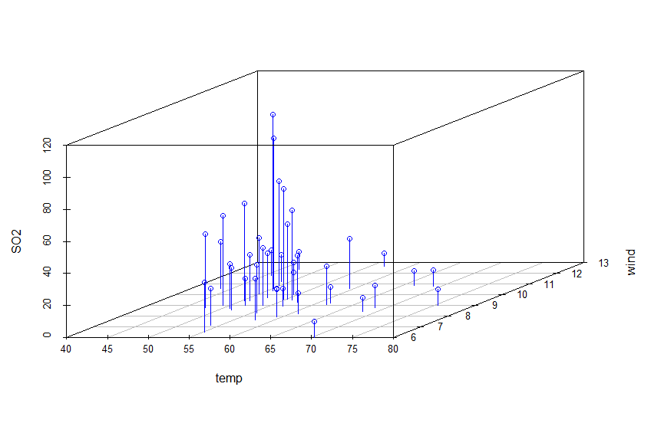
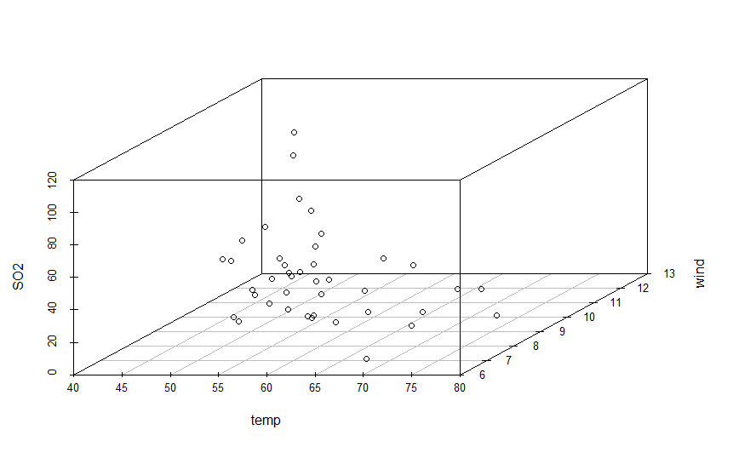
2. Three-Dimensional Scatterplots
Example 2.3.2 Draw a three-dimensional scatterplot for temp, wind, and SO2.
library("scatterplot3d")
with(usairpollution, scatterplot3d(temp,wind,SO2,type="h“, color=“blue”, angle=30))
with(usairpollution, {scatterplot3d(temp, wind, SO2,)})
type="h", # lines to the horizontal plane

Slide 43
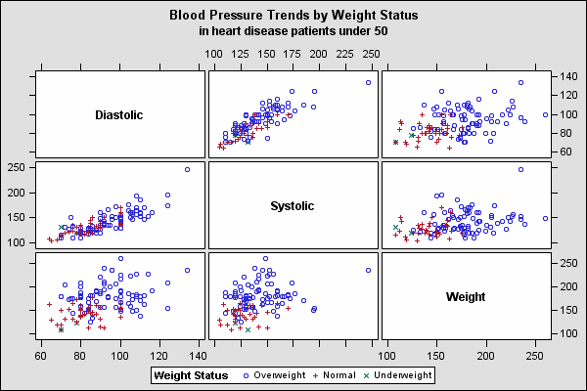
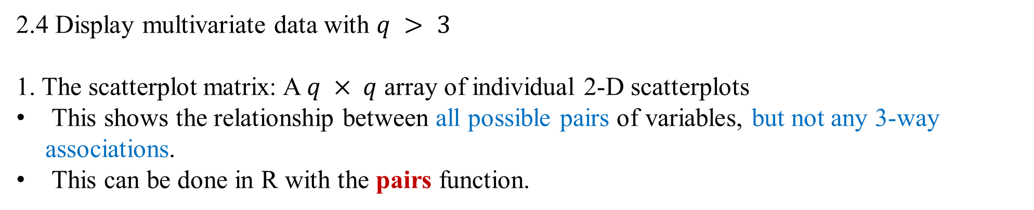
2.4 Display multivariate data with $q > 3$
1. The scatterplot matrix: A $q × q$ array of individual 2-D scatterplots
This shows the relationship between all possible pairs of variables, but not any 3-way associations.
This can be done in R with the pairs function.

Slide 44
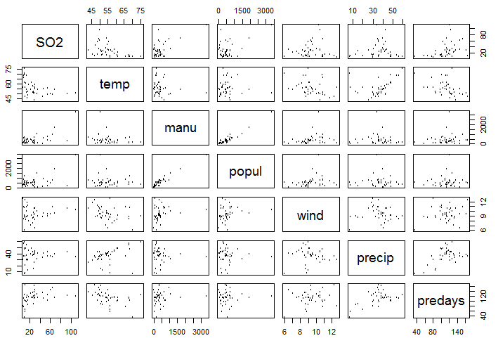
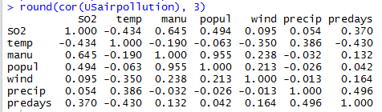
Example 2.4.1
a. Draw a scatterplot matrix of the air pollution data and compute the correlation
coefficients with three decimal places.
pairs(usairpollution, pch = 1, cex = .5)
round(cor(usairpollution), 3)

Slide 45
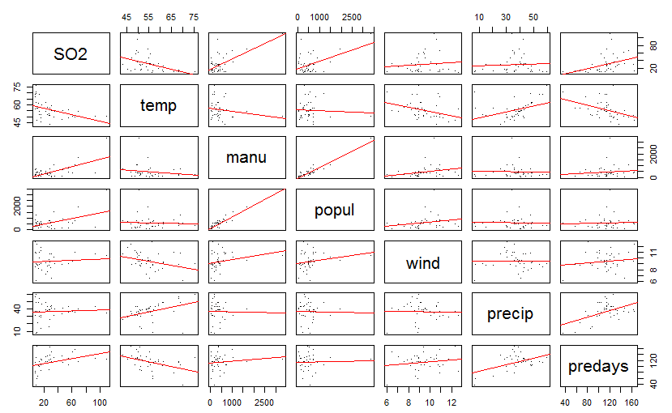
Example 2.4.1
a. Draw a scatterplot matrix of the air pollution data and compute the correlation
coefficients with three decimal places.
b. Showing the linear fit of each pair of variables in the scatterplot matrix.
pairs(usairpollution, pch = 1, cex = .5)
round(cor(usairpollution), 3)
pairs(usairpollution, panel = function (x, y, ...) {points(x,y,...); abline(lm(y~x), col = "red")}, pch = ".", cex = 1.5)

Slide 46
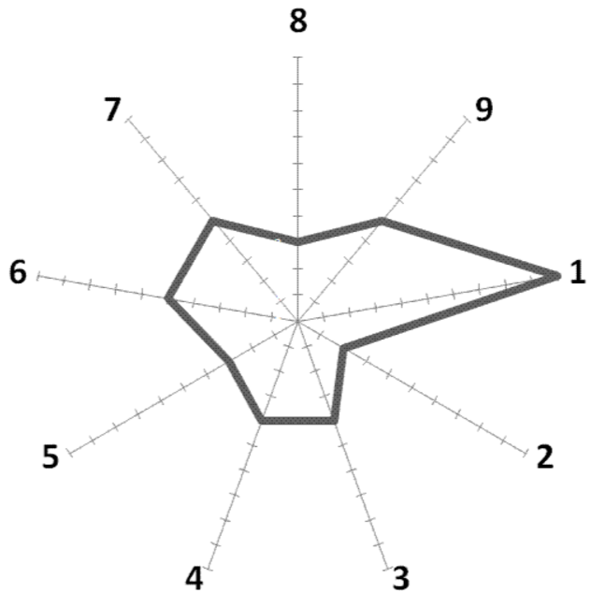
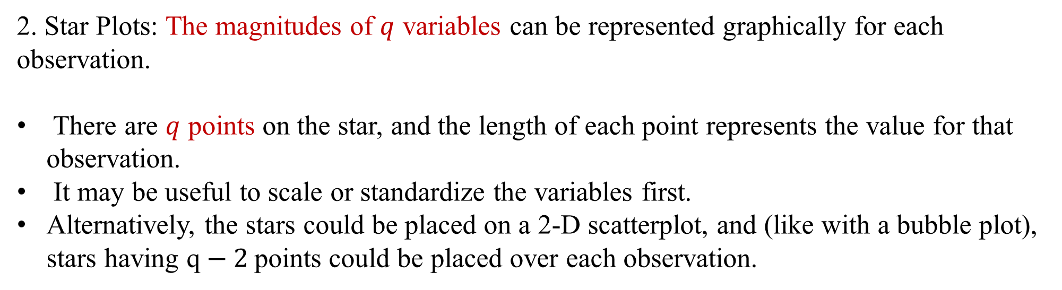
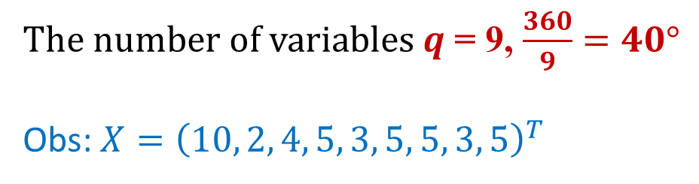
2. Star Plots: The magnitudes of $q$ variables can be represented graphically for each observation.
There are $q$ points on the star, and the length of each point represents the value for that observation.
It may be useful to scale or standardize the variables first.
Alternatively, the stars could be placed on a 2-D scatterplot, and (like with a bubble plot), stars having q$− 2$points could be placed over each observation.
$The number of variables q$ = 9, $\frac{360}{9}=40°$
Obs: $X={\left(10, 2, 4, 5, 3, 5, 5, 3, 5\right)}^{T}$

Slide 47
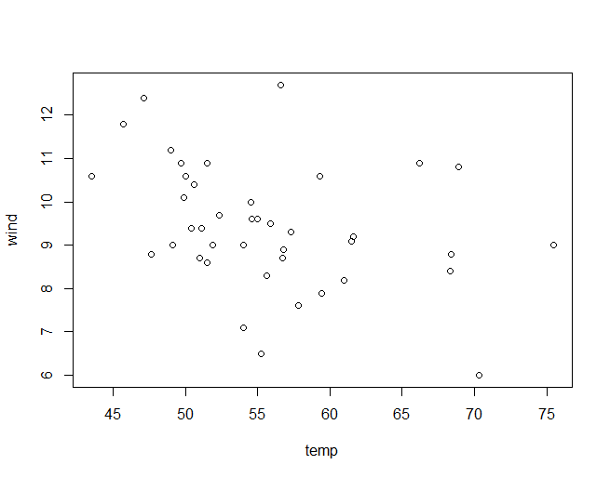
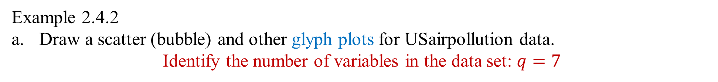
Example 2.4.2
Draw a scatter (bubble) and other glyph plots for USairpollution data.
Identify the number of variables in the data set: $q=7$
ylim <- with(usairpollution, range(wind)) * c(0.95, 1)
plot(wind ~ temp, data = usairpollution,
xlab = "Average annual temperature (Fahrenheit)",
ylab = "Average annual wind speed (m.p.h.)", pch = 10,
ylim = ylim)

Slide 48
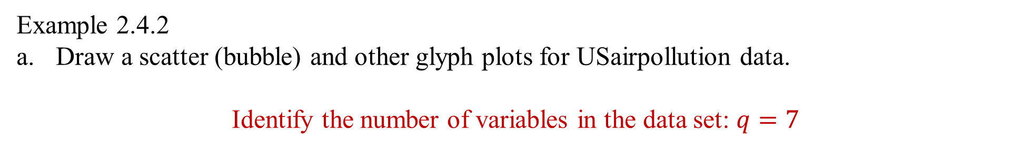
Example 2.4.2
Draw a scatter (bubble) and other glyph plots for USairpollution data.
Identify the number of variables in the data set: $q=7$
ylim <- with(usairpollution, range(wind)) * c(0.95, 1)
plot(wind ~ temp, data = usairpollution,
xlab = "Average annual temperature (Fahrenheit)",
ylab = "Average annual wind speed (m.p.h.)", pch = 10,
ylim = ylim)
with(usairpollution,
stars(usairpollution[,-c(2,5)], locations = cbind(temp, wind), labels = NULL, add = TRUE, cex = 0.5))
Removing

Slide 49
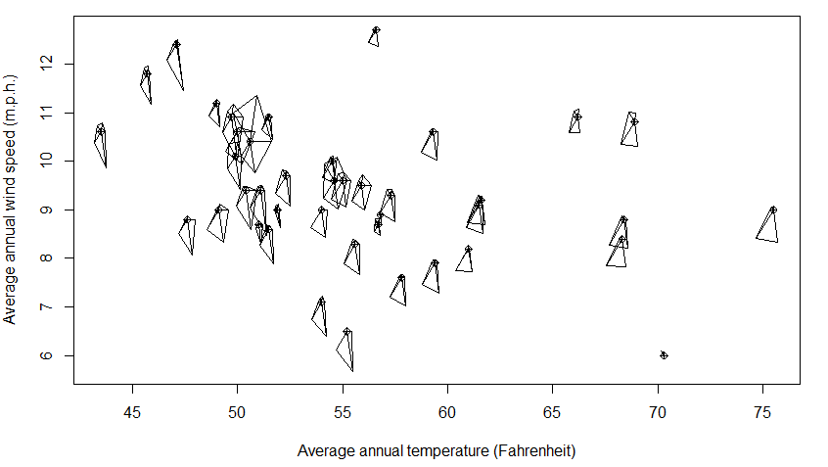
Example 2.4.2
a. Draw a bubble and other glyph plots for USairpollution data.

Slide 50
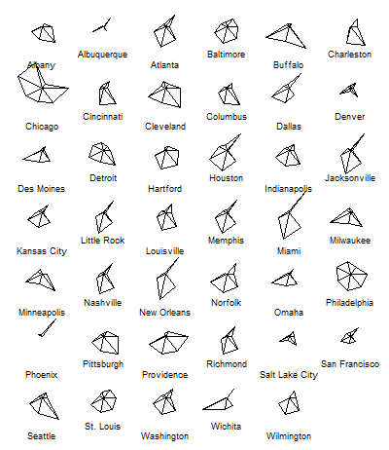
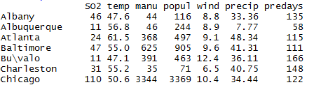
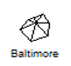
Example 2.4.2
b. Draw a star plot for USairpollution data.
stars(usairpollution, cex = 0.55)

Slide 51

2.5 Enhancing the scatterplot with estimated bivariate distribution
Old faithful:
Duration vs. waiting time
Scatter plot
Examining the association between variables
Highlighting outliers

Slide 52

2.5 Enhancing the scatterplot with estimated bivariate distribution
Eruptions vs. waiting time
Scatter plot
Identifying regions where there are high or low densities of observations that may indicate the presence of distinct groups of observations; i.e., “clusters”.
A bivariate density estimate is simply an approximation to the bivariate p.m.f. of two variables obtained from a sample.
A p.m.f. may obtained by
Kernel density estimate

Slide 53

Old faithful:
Duration vs. waiting time
Scatter plot
Old faithful 2D density estimate
Contour plot
Kernel density estimate

Slide 54



In kernel density estimation, the contribution of each data point is smoothed out from a single point into a region of space surrounding it.
using kernels to combine local estimates in a smooth curvy
Univariate:
x₁ = −2.1
x₂ = −1.3
x₃ = −0.4
x₄ = 1.9
x₅ = 5.1,
x₆ = 6.2
K(x) = ϕ(x), where ϕ is the standard normal density

Slide 55
The kernel density estimate
The density estimation is to take a sample of data and to make inferences about the underlying probability density function everywhere, including where no data are observed.
In kernel density estimation, the contribution of each data point is smoothed out from a single point into a region of space surrounding it. Aggregating the individually smoothed contributions gives an overall picture of the structure of the data and its density function.

Slide 56



Kernel functions in common use

Slide 57

Example 2.5.1 Draw the three kernel functions (uniform, triangle, and normal) in R.

Slide 58


Example 2.5.1 Draw the three kernel functions in R.

Slide 59

Example 2.5.1 Draw the three kernel functions in R.

Slide 60

Example 2.5.2 Use normal distribution as the kernel to estimate univariate density for given sample:
0, 1, 1.1, 1.5, 1.9, 2.8, 2.9, 3.5

Slide 61



Example 2.5.2 Use normal distribution as the kernel to estimate univariate density for given sample:
0, 1, 1.1, 1.5, 1.9, 2.8, 2.9, 3.5
library ("MVA")
library("HSAUR2")
gauss((xgrid - a)/h)/(n * h))

Slide 62




Example 2.5.2 Use normal distribution as the kernel to estimate univariate density for given sample:
0, 1, 1.1, 1.5, 1.9, 2.8, 2.9, 3.5

Slide 63


2.5 Enhancing the scatterplot with estimated bivariate distribution
Eruptions vs. waiting time
A bivariate density estimate is simply an approximation to the bivariate p.d.f. of two variables obtained from a sample.

Slide 64

Example 2.5.3
Use a three-dimensional plot to picture the bivariate Epanechnikov kernel given by
epa <- function(x, y) ((x^2 + y^2) < 1) * 2/pi * (1 - x^2 - y^2)
x <- seq(from = -1.1, to = 1.1, by = 0.05)
epavals <- sapply(x, function(a) epa(a, x))
persp(x = x, y = x, z = epavals, xlab = "x", ylab = "y", zlab = expression(K(x, y)), theta = -35, axes = TRUE,
box = TRUE)

Slide 65

2.5 Three-dimensional plots and contour plots to picture bivariate distribution
Example 2.5.3 a. Use a three-dimensional plot to picture normal distribution with mean vector of zero and covariance matrix of identity.
b. Use a three-dimensional plot to picture the bivariate Epanechnikov kernel given by

Slide 66


Review contour plot from Calculus III
A contour plot is a graphical technique for representing a 3-dimensional surface by plotting constant z slices, called contours, on a 2-dimensional format.

Slide 67

How do we draw a map of Bryce Canyon in 2d spaces and also show the height of the mountain
We have to find the way to place the third dim (z) in the 2d space

Slide 68

Draw a map of Bryce Canyon in 2d spaces and also show the height of the mountain
Projection of intersecting curves onto the xy-plane

Slide 69
2.5 Use 3-D plots and contour plots to picture bivariate distribution
A contour plot is a graphical technique for representing a 3-dimensional surface by plotting constant z slices, called contours, on a 2-dimensional format.
For given 2d sample data, how do we estimate the function of the surface ?

Slide 70

Old faithful:
Duration vs. waiting time
Scatter plot
Old faithful 2D density estimate
Contour plot
Kernel density estimate
Perspective plot

Slide 71
library(ks)
library(xlsx) #need to install 64-bit java at https://www.java.com/en/download/manual.jsp, and then xlsx package
data(faithful)
H <- Hpi(x=faithful)
fhat <- kde(x=faithful, H=H)
plot(fhat, display="filled.contour2")
points(faithful, cex=0.5, pch=16)
library("KernSmooth")
faithfuld<-bkde2D(faithful, bandwidth = sapply(faithful, dpik))
plot(faithful, xlab = "Duration", ylab = "Waiting time")
contour(x = faithfuld$x1, y = faithfuld$x2, z =faithfuld$fhat, add = TRUE)

Slide 72


Example 2.5.4
a. Use a contour plot to estimate the bivariate distribution given by data in table 2-1.
plot(logli~logst, data=cygob1)

Slide 73


Example 2.5.2
a. Use a contour plot to estimate the bivariate distribution given by data in table 2-1.
Three data sets are needed to draw a contour plot
Variable x
Variable y
Contour values f hat

Slide 74
Example 2.5.2
a. Use a contour plot to estimate the bivariate distribution given by data in table 2-1.
library("KernSmooth")
cygob1<-read.csv("D:/STAT 4400/Data/cygob1.csv", head=TRUE)
CYGOB1d <- bkde2D(cygob1, bandwidth = sapply(cygob1, dpik))
plot(cygob1, xlab = "log surface temperature", ylab = "log light intensity")
contour(x = CYGOB1d$x1, y = CYGOB1d$x2, z = CYGOB1d$fhat, add = TRUE)

Slide 75


Example 2.5.4 Use a three-dimensional plot to estimate the bivariate distribution given by data in Table 2-1.
library("KernSmooth")
cygob1<-read.csv("D:/STAT 4400/Data/cygob1.csv", head=TRUE)
persp(x = CYGOB1d$x1, y = CYGOB1d$x2, z = CYGOB1d$fhat, xlab = "log surface temperature", ylab = "log light intensity", zlab = "density“)

Slide 76

Homework: Draw a scatterplot matrix of body measurements data showing the estimated bivariate densities on each panel.

Slide 77


2.6 Conditioning Plots (Trellis graphics)
Show scatterplots of two (three) variables, conditional on the value of a third (fourth) variable.
The number of variables?
$$q=$$
The type of the variables?
Car Weight

Slide 78


These are separate scatterplots for different values of the third (fourth) variable.
These are especially useful if the third variable is a categorical (grouping) variable.
This can be done in R with the coplot function or with the xyplot function in the lattice package.

Slide 79
2.6 Conditioning Plots (Trellis graphics)
Example 2.6.1 a. Draw a scatterplot of SO2 and temp for light and high winds.
light wind
high wind
The number of variables?
The type of the variables?
What is the structure of the plot?
SO2
temp

Slide 80

2.6 Conditioning Plots (Trellis graphics)
Example 2.6.1 a. Draw a scatterplot of SO2 and temp for light and high winds.
library("lattice")
usairpollution<-read.csv("D:/STAT 4400/Data/USairpollution.csv",head=TRUE,row.names=1)
plot(xyplot(SO2~temp| cut(wind,2), data=usairpollution))

Slide 81
2.6 Conditioning Plots (Trellis graphics)
Example 2.6.1 b. Draw a three-dimensional plots of temperature, wind, and precipitation conditioned on levels of SO2.
The number of variables?
The type of the variables?
What is the structure of the plot?

Slide 82

2.6 Conditioning Plots (Trellis graphics)
Example 2.6.1 b. Draw a three-dimensional plots of temperature, wind, and precipitation conditioned on four levels of SO2.
SO2-3
SO2-4
The number of variables?
The type of the variables?
What is the structure of the plot?
SO2-1
SO2-2

Slide 83

2.6 Conditioning Plots (Trellis graphics)
Example 2.6.1 b. Draw a three-dimensional plots of temperature, wind, and precipitation conditioned on four levels of SO2.
pollution <- with(usairpollution, equal.count(SO2,4))
plot(cloud(precip~temp * wind | pollution, panel.aspect = 0.9,data = usairpollution))

Slide 84

Example 2.6.2 a. Draw scatterplots of latitude and longitude conditioned on three ranges of depth in quakes data.
b. Draw scatterplots of latitude, longitude, and depth conditioned on magnitude.
c. Draw scatterplots of latitude and longitude conditioned on magnitude, with depth coded by shading.
plot(xyplot(lat~long| cut(depth, 3), data = quakes,layout = c(3, 1),
xlab = "Longitude", ylab = "Latitude"))

Slide 85
2.7 Prole Plots
Prole plots are a simple way to display several multivariate observations graphically.
They show connected line segments where the height at each joining point is the value of a variable for that observation.
Another form of prole plot uses a series of bars to represent the variable values for each multivariate observation.
These work best when there are relatively few observations (and variables) so that the plot looks “cleaner”.
Plotting the different observations in different colors (or line types) helps distinguish the observations.
Prole plots for the same data set can appear different visually when the variables are reordered (a possible weakness)

